Slide 1
Wayne County Community Mobility Study
Wayne County Commission
March 15, 2021

Slide 2
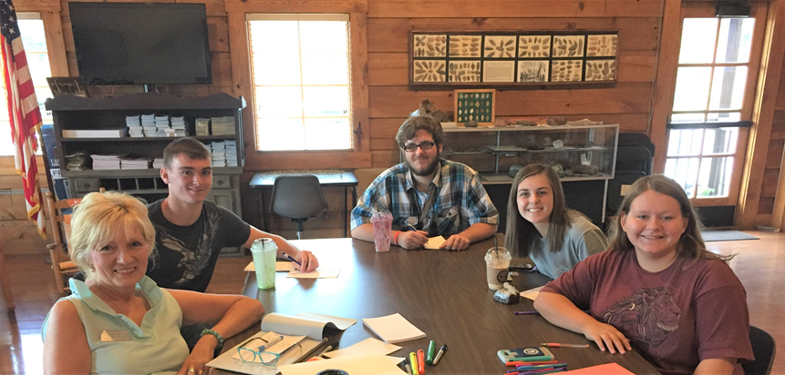
The Big Idea
May 2018 Youth Leadership Wayne Summit
Tri-Town Transportation “Think Tank”
Fixed route transportation
Education and tourism

Slide 3
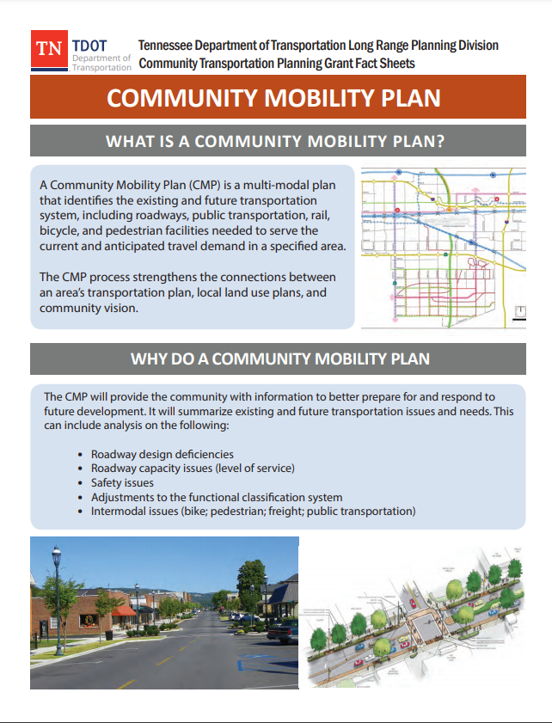
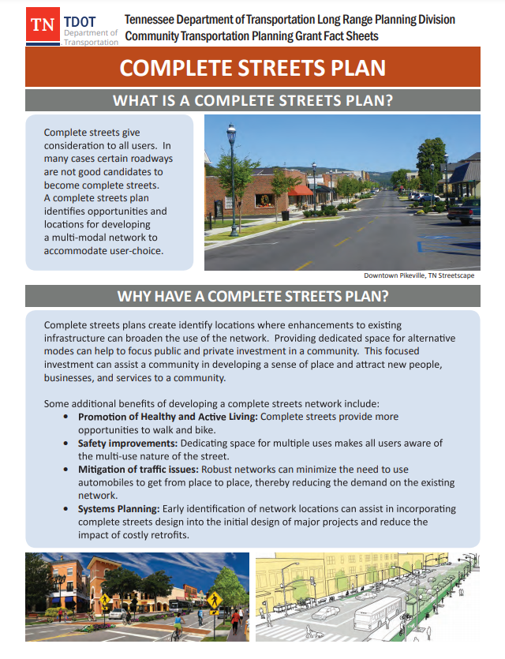
Rural Community Transportation Planning Grant

Slide 4
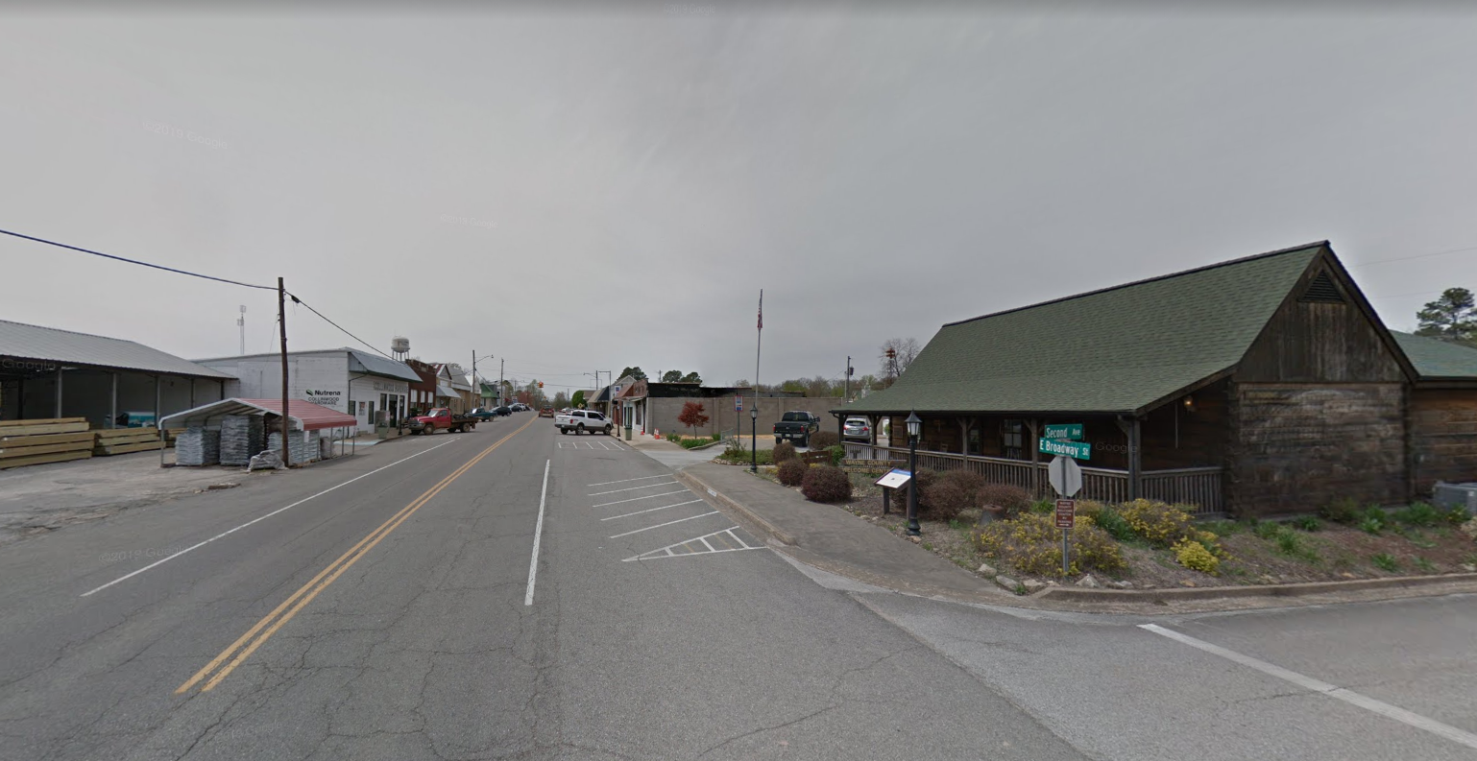
Wayne County Community Mobility Study
Meet mobility needs
Finding Wayne County’s “best fit”
Cost-effective solutions

Slide 5
Why public transportation?
Almost 4 out 10 Wayne County residents are younger than 18 or older than 64
Source: American Community Survey

Slide 6
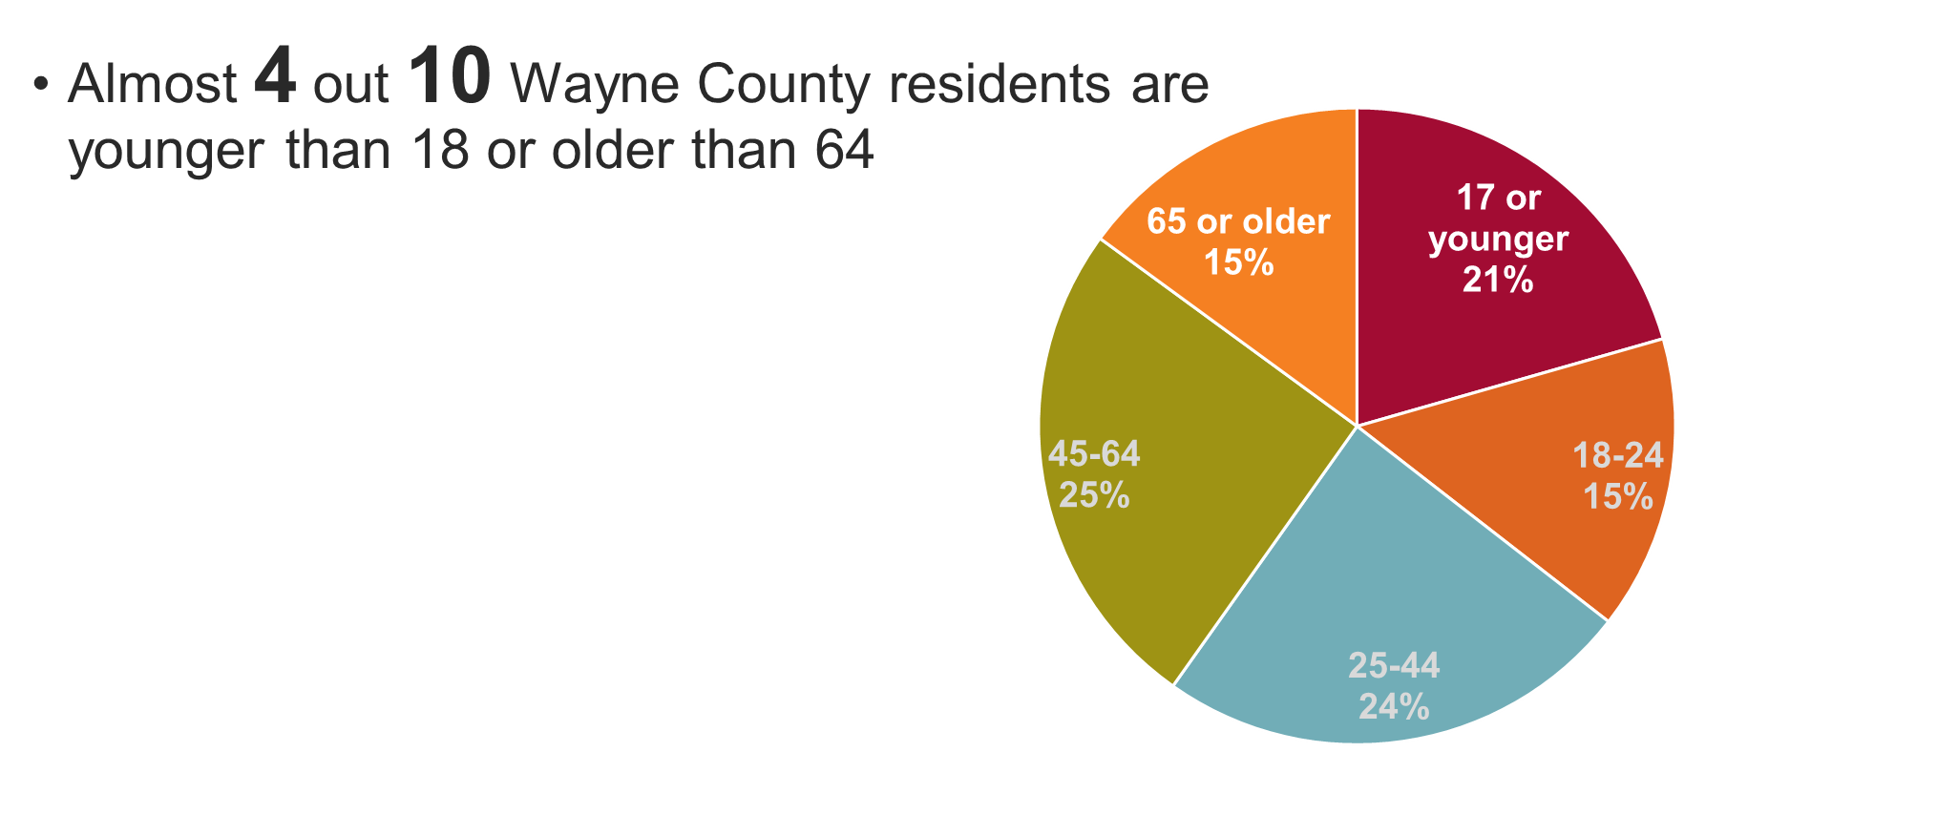
Why public transportation?
Public transportation represents freedom for people who cannot or are unable to drive.

Slide 7
Why public transportation?
One third of Wayne County households have one or no vehicle
+
Source: American Community Survey

Slide 8
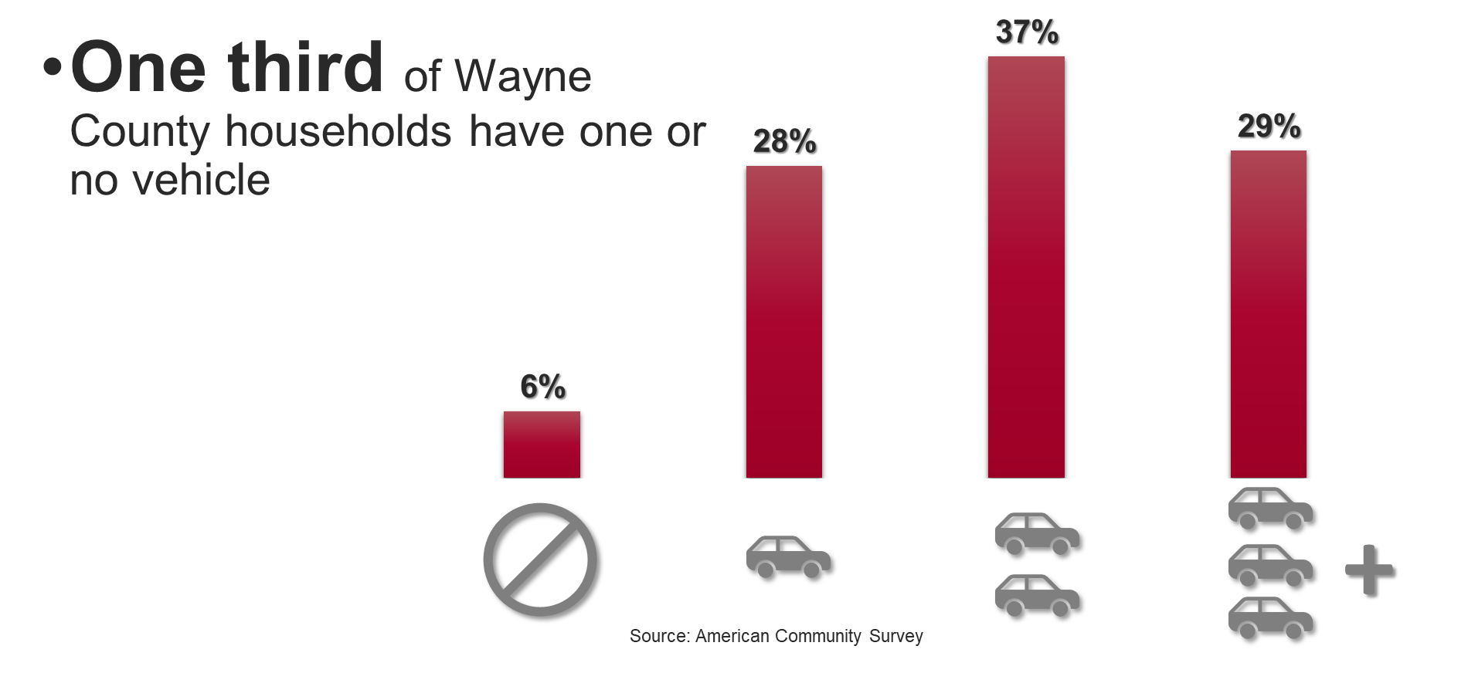
Why public transportation?
Public transportation connects residents to employment, education and other opportunities.
Source: American Commnity Survey

Slide 9
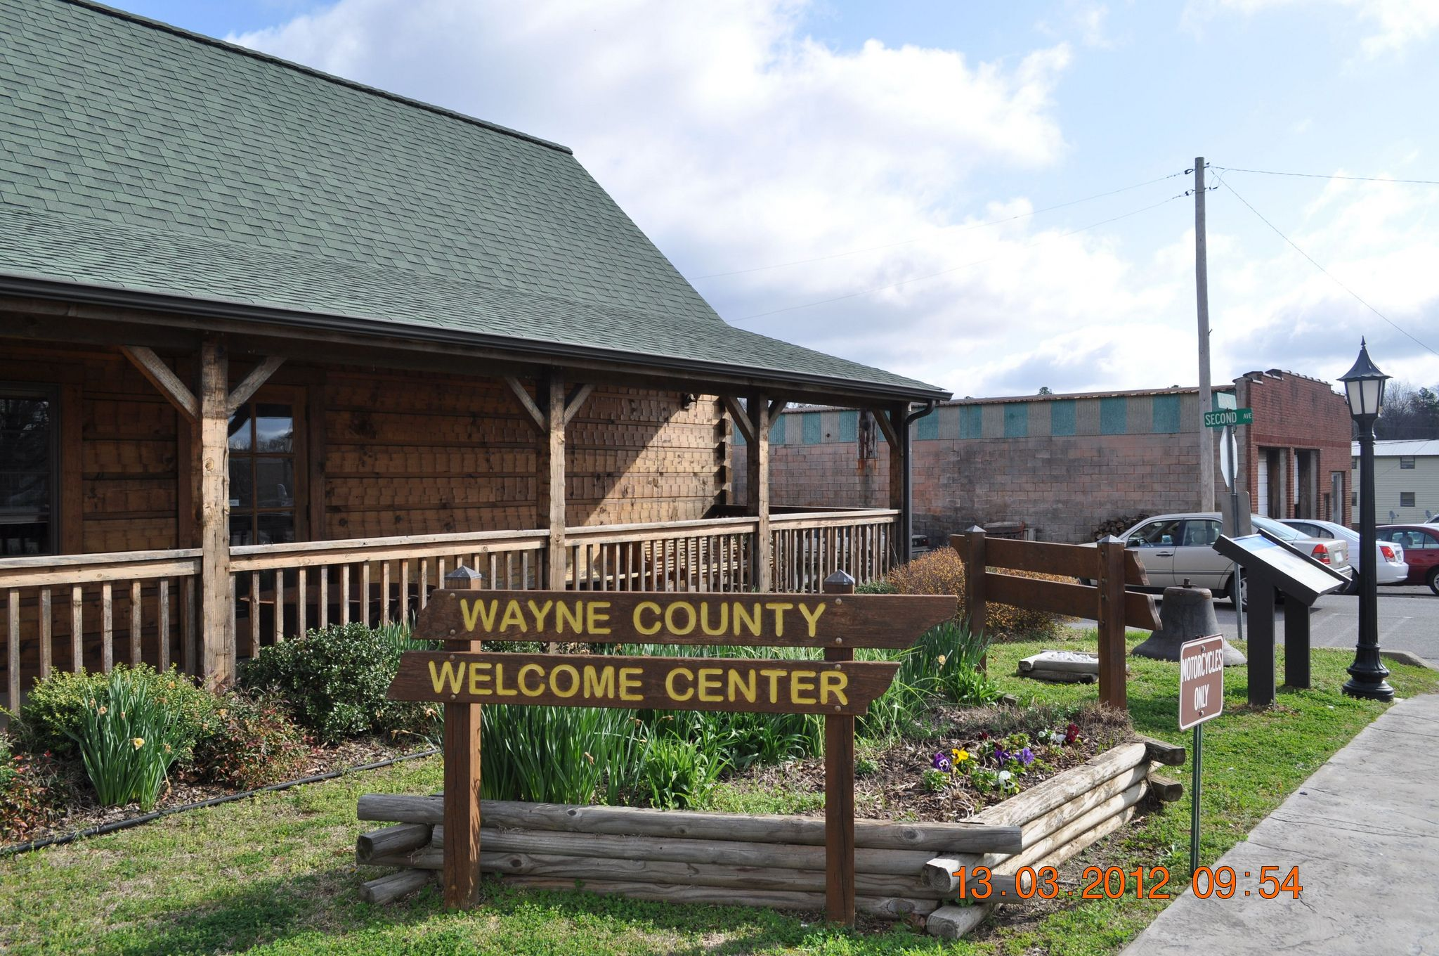
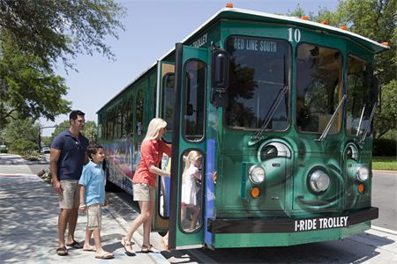
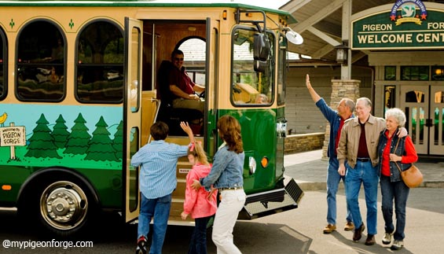
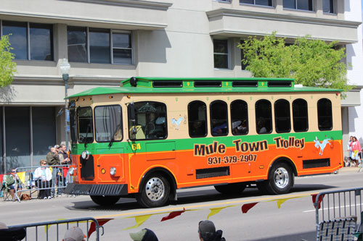
Why public transportation?
Public transportation can play an important role in a successful tourism experience

Slide 10
Questions the plan will answer
Where will it serve?
When will it run?
Who will ride?
How will they get to the stops?
Who will operate the system?
What will it cost?
Who might help pay for it?

Slide 11
What’s next?
Feb.
Mar.
Apr.
May
Jun.
Jul.
Field Visit and Existing Conditions

Public Meeting No. 1
Proposed Options

Public Meeting No. 2
Recommendations and Final Plan

Final Presentation

Slide 12
Take our survey!
www.surveymonkey.com/r/MoveWayneCo

Slide 13
Thank You!

